Slide 1
S.O.L.I.D.
The Benefits and Potential of Using SOLID Principles
S
Single Responsibility
O
Open/Closed
L
Liskov substitution
I
Interface Segregation
D
Dependency Inversion
SoftUni Team
Technical Trainers
Software University
https://softuni.bg

Slide 2

Table of Contents
S.O.L.I.D. Principles
Single Responsibility
Open / Closed
Liskov Substitution
Interface Segregation
Dependency Inversion

Slide 3
Have a Question?
sli.do
#java-advanced

Slide 4
SOLID Principles
SOLID

Slide 5
S.O.L.I.D.
S – Single responsibility principle – class should only have one responsibility
O – Open–closed principle – open for extension, but closed for modification
L – Liskov substitution principle – objects should be replaceable with instances of their subtypes without altering the correctness of that program

Slide 6
S.O.L.I.D.
I – Interface segregation principle – many specific interfaces are better than one general interface
D – Dependency inversion principle – one should depend upon abstractions, not concretions

Slide 7


Single Responsibility

Slide 8
Single Responsibility Principle
A class should have only one responsibility
Reduces dependency complexity
Each additional responsibility is an axis to change the class
public class HeroSettings {
public static void changeName(Hero hero) {
// Grant option to change
}
}
8

Slide 9
Single Responsibility Principle
Still classes can have multiple methods
Each method should have single functionality part of the class responsibility
public class HeroSettings {
public static void changeName(Hero hero) {
// Grant option to change name
}
public static void selectRole(Hero hero) {
// Grant option to select role
}
}
9

Slide 10


Open / Closed

Slide 11
What is Open/Closed?
Software entities (classes, modules, functions, etc.) should be
open for extension
closed for modification
Design the code in a way that new functionality can be added with minimum changes in the existing code
11

Slide 12

Extensibility
Implementation takes future growth into consideration
New or modified functionality affects little or not at all the internal structure and data flow of the system

Slide 13

Reusability
Software reusability refers to design features of a software element that enhance its suitability for reuse
Modularity
Low coupling
High cohesion
Coupling and Cohesion

Slide 14

OCP – Violations
Cascading changes through modules
Each change requires re-testing
Logic depends on conditional statements

Slide 15

OCP – Solutions
Inheritance / Abstraction
Inheritance / Template Method pattern
Composition / Strategy patterns

Slide 16

Liskov Substitution

Slide 17
What is Liskov Substitution?
Derived types must be completely substitutable for their base types
Reference to the base class can be replaced with a derived class without affecting the functionality of the program module
Derived classes extend without replacing the functionality of old classes
17

Slide 18
LSP Relationship
OOP Inheritance
Plus LSP
Student IS-A Person
Student IS-SUBSTITUTED-FOR Person

Slide 19
OCP vs LSP
Liskov Substitution Principle is just an extension of the Open Closed Principle
We must make sure that new derived classes are extending the base classes without changing their behavior
19

Slide 20
LSP – Violations and Solutions
Violations
Type Checking
Overridden methods say "I am not implemented"
Base class depends on its subtypes
Solutions
Refactoring in the base class

Slide 21

Interface Segregation

Slide 22
ISP – Interface Segregation Principle
Clients should not be forced to depend on methods they do not use
Segregate interfaces
Prefer small, cohesive interfaces
Divide "fat" interfaces into "role" interfaces

Slide 23
Fat Interfaces
Classes whose interfaces are not cohesive have "fat" interfaces
public interface Worker {
void work();
void sleep();
}
Class Employee is OK
public class Robot implements Worker {
public void work() {}
public void sleep() {
throw new UnsupportedOperationException();
}
}

Slide 24
"Fat" Interfaces
Having "fat" interfaces:
Classes have methods they do not use
Increased coupling
Reduced flexibility
Reduced maintainability

Slide 25
How to ISP?
Solutions to broken ISP
Small interfaces
Cohesive interfaces
Let the client define interfaces – "role" interfaces

Slide 26
Cohesive Interfaces
Small and Cohesive "Role" Interfaces
public interface Worker {
void work();
}
public interface Sleeper {
void sleep();
}
public class Robot implements Worker {
void work() {
// Do some work…
}
}

Slide 27
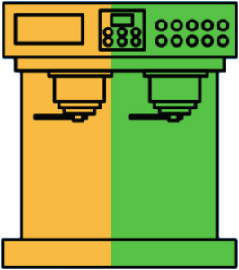
Dependency Inversion

Slide 28
Dependency Inversion Principle (DIP)
High-level modules should not depend on low-level modules
Both should depend on abstractions
Abstractions should not depend on details
Details should depend on abstractions
Goal: decoupling between modules through abstractions

Slide 29
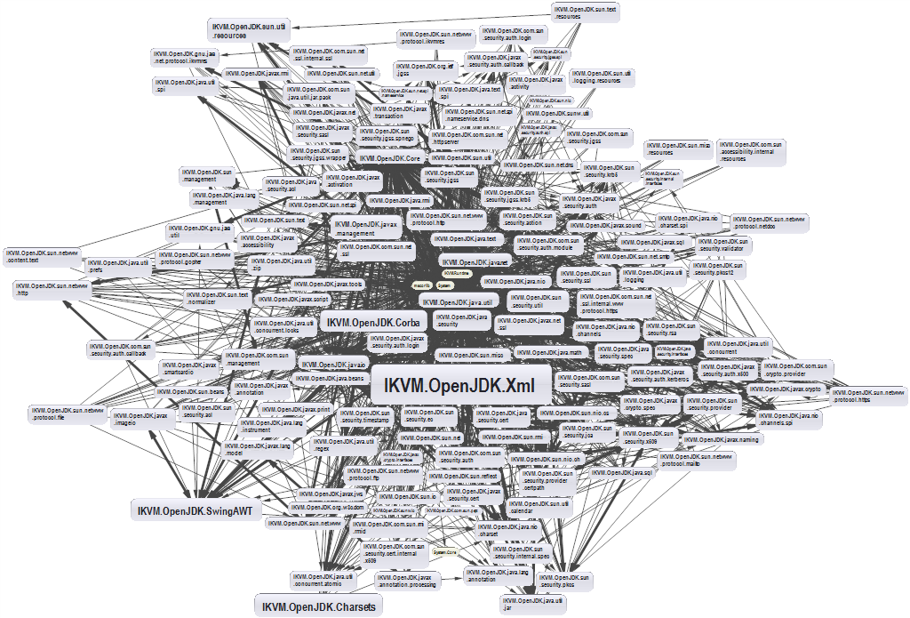
Dependencies and Coupling (1)
What happens when modules depend directly on other modules

Slide 30
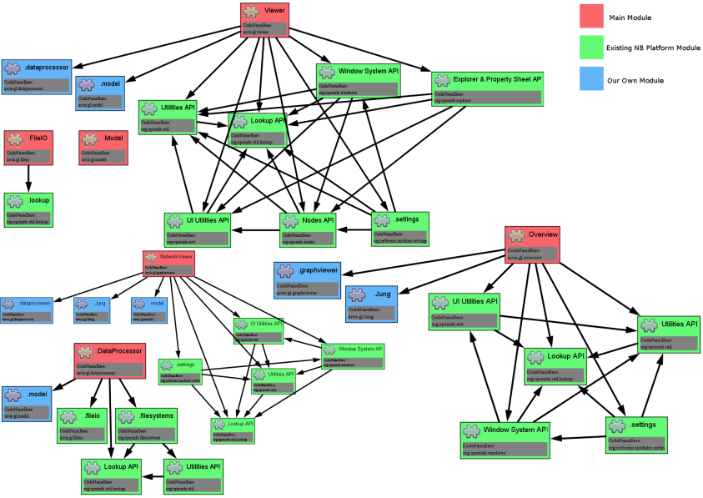
Dependencies and Coupling (2)
The goal is to depend on abstractions

Slide 31
The Problem
Button → Lamp Example – Robert Martin
Button depends on Lamp
High-level / Client
Lamp
turnOn()
turnOff()
Button
poll()
Low-level / Server

Slide 32
Dependency Inversion Solution
Find the abstraction independent of details
SwitchableDevice
<interface>
turnOn()
turnOff()
Button
poll()
uses
Client defines interfaces
implements
Lamp

Slide 33
Dependency Examples
A dependency is any external component / system:
Framework
Third party library
Database
File system
Email
Web service
System resource (e.g. clock)
Configuration
The new keyword
Static method
Global function
Random generator
System.in / System.out

Slide 34

How to DIP? (1)
Constructor injection - dependencies are passed through constructors
Pros
Classes self-documenting requirements
Works well without container
Always valid state
Cons
Many parameters
Some methods may not need everything

Slide 35
Constructor Injection – Example
public class Copy {
private Reader reader;
private Writer writer;
public Copy(Reader reader, Writer writer) {
this.reader = reader;
this.writer = writer;
}
public void copyAll() {}
}

Slide 36
How to DIP? (2)
Setter Injection - dependencies are passed through setters
Pros
Can be changed anytime
Very flexible
Cons
Possible invalid state of the object
Less intuitive

Slide 37
Setter Injection – Example
public class Copy {
private Reader reader;
private Writer writer;
public void setReader(Reader reader) {}
public void setWriter(Writer writer) {}
public void copyAll() {}
}

Slide 38
How to DIP? (3)
Parameter injection - dependencies are passed through method parameters
Pros
No change in rest of the class
Very flexible
Cons
Many parameters
Breaks the method signature
public class Copy {
public void copyAll(Reader reader, Writer writer) {}
}

Slide 39
Layering (1)
Traditional programming
High-level modules use low-level modules
UI Layer
UI Layer
Business Layer
Business Layer
Data Access Layer
Data Access Layer

Slide 40
Layering (2)
Dependency Inversion Layering
High and low-level modules depend on abstractions
Client defines interfaces
UI Layer
<BL Interface>
Business Layer
<DAL Interface>
Data Access Layer

Slide 41
Problem: Employee Info
You are given some classes
Refactor the code so that it conforms to DIP
Main
ConsoleFormatter
EmployeeInfoProvider
EmployeeDatabase

Slide 42
Solution: Employee Info
ConsoleClient
<Formatter>
<InfoProvider>
ConsoleFormatter
EmployeeInfoProvider
<Database>
EmployeeDatabase

Slide 43

Summary
…
…
…
SOLID principles make the software:
Understandable
Flexible
Maintainable

Slide 44
Questions?
Notes:
44

Slide 45



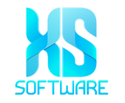





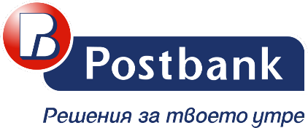

SoftUni Diamond Partners

Slide 46


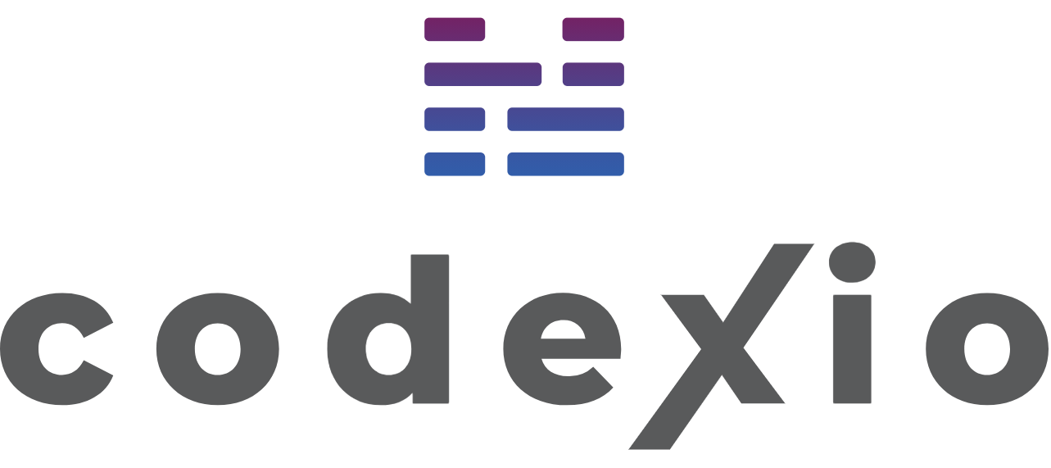
Educational Partners

Slide 47
Trainings @ Software University (SoftUni)
Software University – High-Quality Education, Profession and Job for Software Developers
softuni.bg
Software University Foundation
softuni.foundation
Software University @ Facebook
facebook.com/SoftwareUniversity
Software University Forums
forum.softuni.bg
47
Notes:
47

Slide 48

License
This course (slides, examples, demos, exercises, homework, documents, videos and other assets) is copyrighted content
Unauthorized copy, reproduction or use is illegal
© SoftUni – https://about.softuni.bg
© Software University – https://softuni.bg
Notes:
48

